Slide 1
Brain
Infographics
Here is where this template begins
This template has been created by Slidesgo

Slide 2
Brain Infographics
Venus
Mercury
Venus is the second planet from the Sun
It’s the closest planet to the Sun
Jupiter
Mars
Jupiter is the biggest planet of them all
Mars is actually a very cold place
This template has been created by Slidesgo

Slide 3
Brain Infographics
Saturn was named after a Roman god
Mars is full of iron oxide dust
Jupiter was named after a Roman god
Earth is the planet on which we all live
This template has been created by Slidesgo

Slide 4
Brain Infographics
Venus
Jupiter
Neptune is very far away from us
Venus is the second planet from the Sun
It’s the biggest planet in the Solar System
This template has been created by Slidesgo

Slide 5
Brain Infographics
A
Saturn is a gas giant and has several rings
B
Earth is the third planet from the Sun and has life
C
Jupiter is a gas giant and has around eighty moons
This template has been created by Slidesgo

Slide 6
Brain Infographics
Mercury
It’s the closest planet to the Sun
Mars
Mars is actually a very cold place
75%
25%
Venus
V
50%
Venus has a toxic atmosphere
This template has been created by Slidesgo

Slide 7
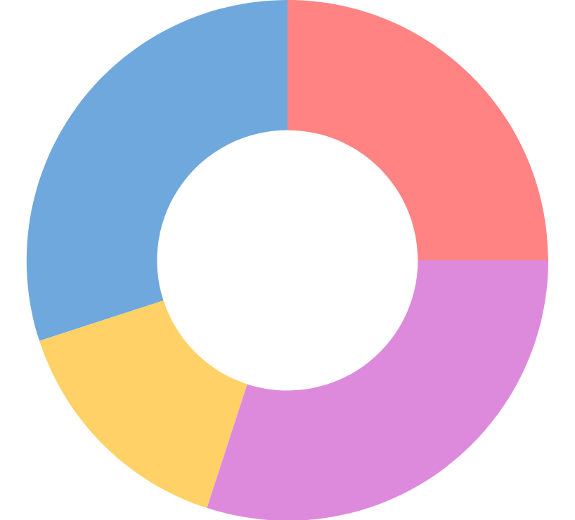
Brain Infographics
30%
25%
Venus is the second planet from the Sun
Earth is the planet with life
15%
30%
Jupiter is the biggest planet of them all
Mars is actually a very cold place
Follow the link in the graph to modify its data and then paste the new one here. For more info, click here
This template has been created by Slidesgo

Slide 8
Brain Infographics
Venus is the second planet from the Sun
Jupiter is the biggest planet of them all
Saturn is a gas giant and has several rings
This template has been created by Slidesgo

Slide 9
Brain Infographics
Mars
Pluto is now considered a dwarf planet
Mercury is the closest planet to the Sun
Venus
Jupiter
Saturn
Neptune
This template has been created by Slidesgo

Slide 10
Brain Infographics
Venus
Jupiter
Earth
Saturn
Venus is the second planet from the Sun
It’s the biggest planet in the Solar System
Earth is the third planet from the Sun and has life
Saturn is a gas giant and has several rings
This template has been created by Slidesgo

Slide 11
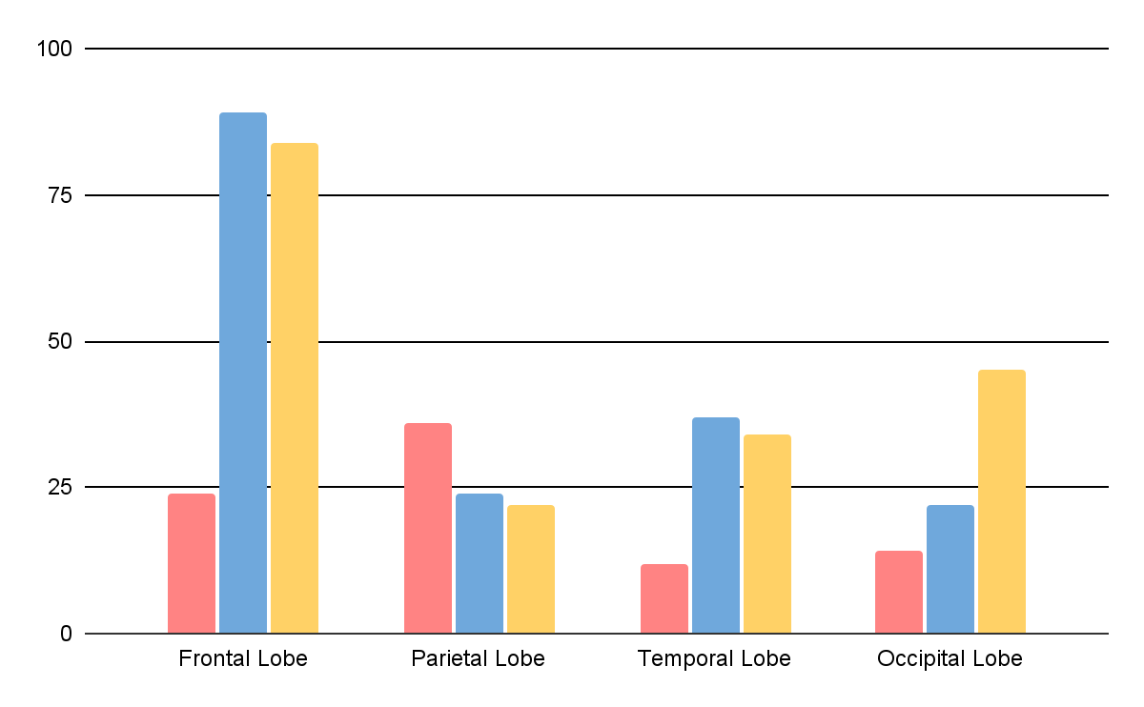
Brain Infographics
Mercury is a very small planet
Mars is actually a very cold place
Venus has a toxic atmosphere
Follow the link in the graph to modify its data and then paste the new one here. For more info, click here
This template has been created by Slidesgo

Slide 12
Brain Infographics
Venus
Earth
Venus is the second planet from the Sun
04
Earth is the planet with life
03
01
Jupiter
Mars
02
Jupiter is the biggest planet of them all
Mars is actually a very cold place
This template has been created by Slidesgo

Slide 13
Brain Infographics
Frontal Lobe | Parietal Lobe | Temporal Lobe | Occipital Lobe
Earth is the third planet from the Sun | Mars is full of iron oxide dust | Jupiter doesn’t have a solid surface | Saturn was named after a Roman god
Earth is the planet on which we all live | Mars was named after a god | Jupiter was named after a Roman god | Saturn is a gas giant and has several rings
This template has been created by Slidesgo

Slide 14
Brain Infographics
Mercury is small
Mercury is very small
Mars is a red planet
Mars is a cold place
Venus is very hot
Venus is a hot planet
This template has been created by Slidesgo

Slide 15
Brain Infographics
Jupiter
Saturn
It’s the biggest planet in the Solar System
Saturn is a gas giant and has several rings
This template has been created by Slidesgo

Slide 16
Brain Infographics
Venus
A
50%
Venus is the second planet from the Sun
B
75%
Mars
A
50%
Mars is actually a very cold place
B
25%
Venus has a toxic atmosphere
Mars is full of iron oxide dust
This template has been created by Slidesgo

Slide 17
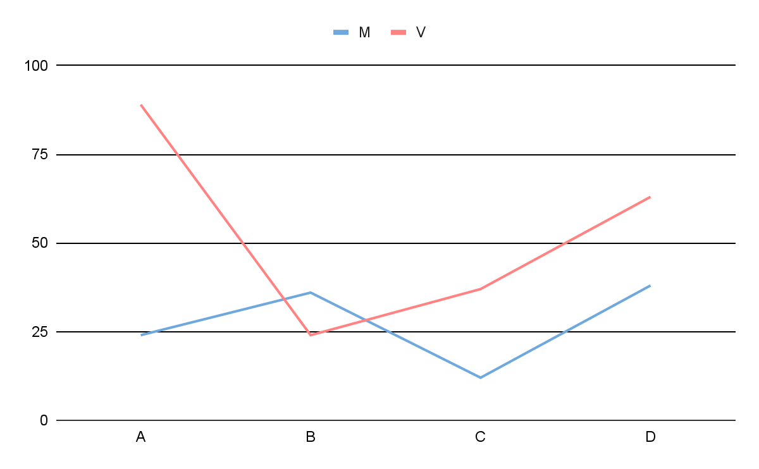
Brain Infographics
Mars
Mars is actually a very cold place
Venus
Venus is the second planet from the Sun
A
Jupiter is big
B
Mars is cold
C
Earth has life
D
Saturn has rings
Follow the link in the graph to modify its data and then paste the new one here. For more info, click here
This template has been created by Slidesgo

Slide 18
Brain Infographics
Dendrite
Nucleus
Axon
Myelin Sheath
Nerve Ending
This template has been created by Slidesgo

Slide 19
Brain Infographics
Venus
Mercury
Venus is the second planet from the Sun
It’s the closest planet to the Sun
Jupiter
Mars
Jupiter is the biggest planet of them all
Mars is actually a very cold place
This template has been created by Slidesgo

Slide 20
Icon pack
This template has been created by Slidesgo

Slide 21
Instructions for use (premium users)
As a Premium user, you can use this template without attributing Slidesgo.
You are allowed to:
Modify this template.
Use it for both personal and commercial purposes.
Share this template in an editable format with people who are not part of your team.
You are not allowed to:
Sublicense, sell or rent this Slidesgo Template (or a modified version of this Slidesgo Template).
Distribute this Slidesgo Template (or a modified version of this Slidesgo Template) or include it in a database or in any other product or service that offers downloadable images, icons or presentations that may be subject to distribution or resale.
Use any of the elements that are part of this Slidesgo Template in an isolated and separated way from this Template.
Register any of the elements that are part of this template as a trademark or logo, or register it as a work in an intellectual property registry or similar.
For more information about editing slides, please read our FAQs or visit our blog:
https://slidesgo.com/faqs and https://slidesgo.com/slidesgo-school

Slide 22
Infographics
You can add and edit some infographics to your presentation to present your data in a visual way.
Choose your favourite infographic and insert it in your presentation using Ctrl C + Ctrl V or Cmd C + Cmd V in Mac.
Select one of the parts and ungroup it by right-clicking and choosing “Ungroup”.
Change the color by clicking on the paint bucket.
Then resize the element by clicking and dragging one of the square-shaped points of its bounding box (the cursor should look like a double-headed arrow). Remember to hold Shift while dragging to keep the proportions.
Group the elements again by selecting them, right-clicking and choosing “Group”.
Repeat the steps above with the other parts and when you’re done editing, copy the end result and paste it into your presentation.
Remember to choose the “Keep source formatting” option so that it keeps the design. For more info, please visit our blog.

